Slide 1
FOS Molecular Data Science 2020
Aging -
a multi-dimensional process:
translation from human to models
Vered Raz
Human Genetics
Leiden University Medical centre

Slide 2

Schedule
When | What: Animal models on ageing | Who | Where
13.30-14.00 | Lecture: aging process and models | Vered Raz
14.00-15.30 | Self Study: Mouse model of Ageing | You
15.30-17.00 | Mouse model of Ageing: Presentation and Discussion | You

Slide 3
Definitions:
A multifactorial process
Aging
Models: human, animals or cellular

Slide 4
What is a multifactorial process?

Slide 5
What is a multifactorial process?
Spatial
- Systemic: all tissues are involved
vs
- A tissue-specific involvement
Temporal (time-dependent)
- Age of onset
- An age-associated pattern
- Progression: linear or non-linear
Molecular (regulators vs. signatures)
- Key regulators vs. multiple regulators
- Key cellular processes vs. multiple processes

Slide 6
What is a multifactorial process?
Spatial
- Systemic: all tissues are involved
vs
- A tissue-specific involvement
Temporal (time-dependent)
- Age of onset
- An age-associated pattern
- Progression: linear or non-linear
Molecular (regulators vs. signatures)
- Key regulators vs. multiple regulators
- Key cellular processes vs. multiple processes
Prediction models

Slide 7
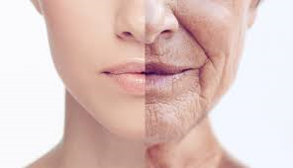
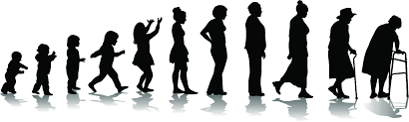
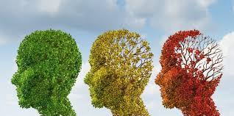
Aging – definition(s)
Notes:
Reproduction?
Natural section?

Slide 8
Aging – definition(s)
Notes:
Reproduction?
Natural section?

Slide 9
Aging – definition(s)
Evolutionary biology:
1. An age-dependent or age-progressive decline in intrinsic physiological function, leading to an increase in age-specific mortality rate and a decrease in age-specific reproductive rate.
2. an age-progressive loss or de-tuning of fitness (natural section) or the state of adaptation.
Britannica:
Progressive physiological changes in an organism that lead to a decline of biological functions and of the organism’s ability to adapt to metabolic stress (senescence).
Senescence: A biological process of growing older in a deleterious (harmful) sense.
Medical: The process of becoming older, a process that is genetically determined and environmentally modulated leading to an increase in disease risk.
WHO:
Biological: a process that is genetically determined and environmentally modulated.
Social: life transitions (causes and/or triggers)
Notes:
Reproduction?
Natural section?

Slide 10
Aging in human
Evolutionary biology:
1. An age-dependent or age-progressive decline in intrinsic physiological function, leading to a decrease in social function and overall activity.
2. an age-progressive loss or de-tuning adaptation.
Britannica:
Progressive physiological changes in an organism that lead to a decline of biological functions and of the organism’s ability to adapt to metabolic stress (senescence).
Senescence: A biological process of growing older in a deleterious (harmful?) sense.
Medical: The process of becoming older, a process that is genetically determined and environmentally modulated leading to an increase in disease risk. – what about the elderly who are are active and healthy?
WHO:
Biological: a process that is epi-genetically determined and environmentally modulated.
Social: life transitions (causes and/or triggers)
Notes:
Reproduction?
Natural section?

Slide 11
Aging- a multifactorial biological process
Development
(embryo)
Lifespan
longevity
Growth
(childhood)
Maintenance
(adolescent)
Decline
(adulthood-elderly)
Onset
progression

Slide 12
Aging- a multifactorial biological process
Development
(embryo)
Lifespan
longevity
Growth
(childhood)
Maintenance
(adolescent)
Decline
(adulthood-elderly)
Onset
progression
When onset start?
Diagnosis (Biomarkers?)
Cellular degeneration
Tissue degeneration
Organ function
Tissue and organ communication
How to study?
- Chronological age?
- Molecular age?
- Metabolic age?

Slide 13
Aging- a multifactorial biological process
Development
(embryo)
Lifespan
longevity
Growth
(childhood)
Maintenance
(adolescent)
Decline
(adulthood-elderly)
Aging: An increase in disease risk
Aging-associated chronic
disorders in
the general population
Adult-onset hereditary
disorders
Healthy

Slide 14
PMID:
30729179
PMID:
30729179
Aging-associated disorders
Hereditable
Non-Hereditable
Mutations: germline
Spontaneous
- de novo
- sporadic
embryo
childhood
adolescent
adulthood-elderly
healthy
diseased
Risk
Genetic loci (2019; PMID 30729179)
Stress
DNA damage
Epigenetics
Environmental
- Metabolic
- Life style

Slide 15
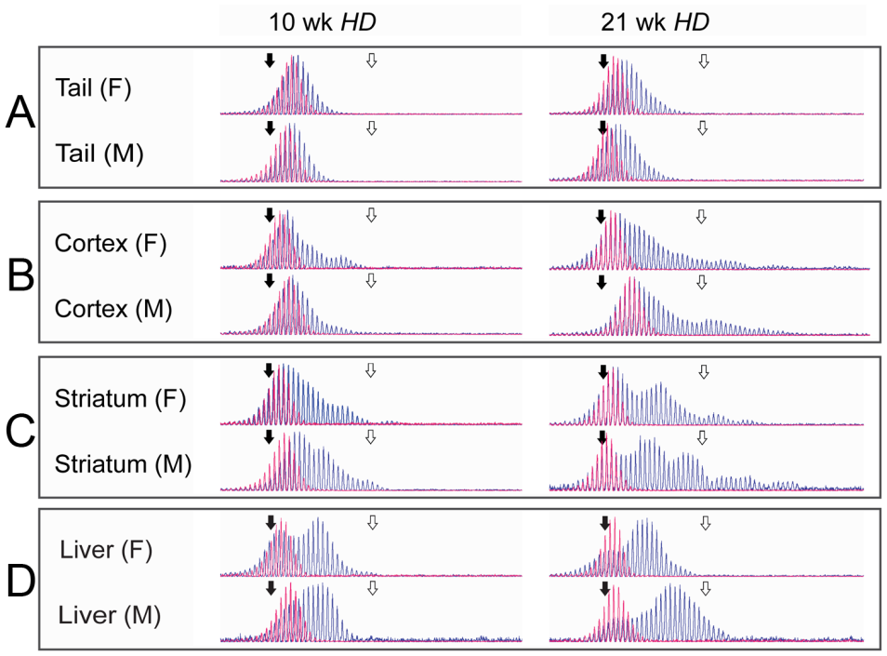
An Age-associated genomic instability
DNA damage
Age-associated somatic instability
Modified from
Andrii I. Rozhok & James DeGregori
Møllersen et al., PLoS Genet 2010

Slide 16
An Age-associated genomic instability
DNA damage
Age-associated somatic instability
Modified from
Andrii I. Rozhok & James DeGregori
Tissue-specific somatic instability
Møllersen et al., PLoS Genet 2010

Slide 17
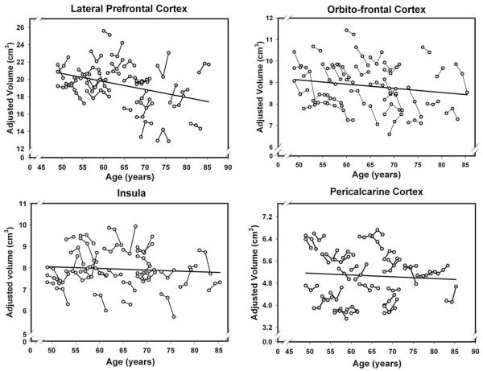
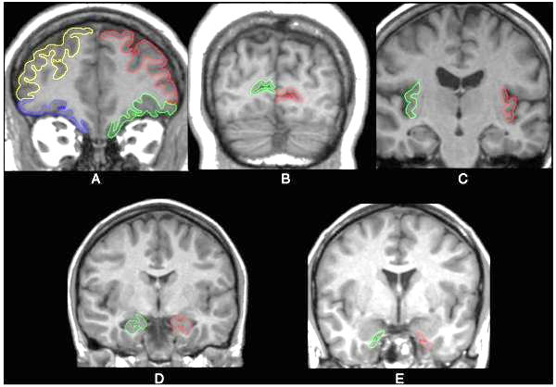
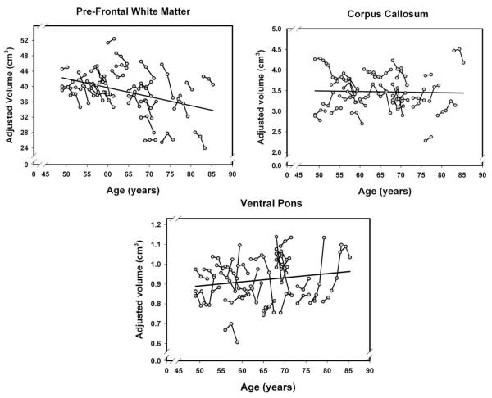
Tissue specific age-associated changes
A. Lateral and orbito-
frontal cortex
B. primary visual cortex
C. insula
D. hippocampus
E. entorhinal cortex
Study design:
Healthy individuals
Longitudinal MRI scan (2-3 per subject)
Age-range: (48-87)
PMID: 20298790

Slide 18
Tissue specific age-associated changes
A. Lateral and orbito-
frontal cortex
B. primary visual cortex
C. insula
D. hippocampus
E. entorhinal cortex
Study design:
Healthy individuals
Longitudinal MRI scan (2-3 per subject)
Age-range: (48-87)
A tissue-specific functional decline within the humn brain
PMID: 20298790

Slide 19
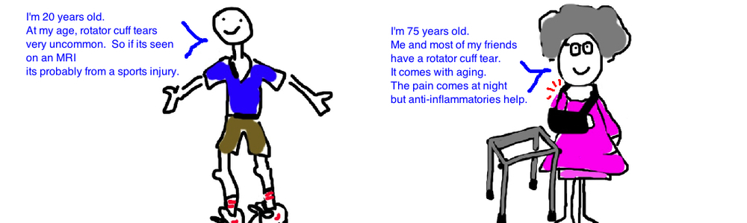
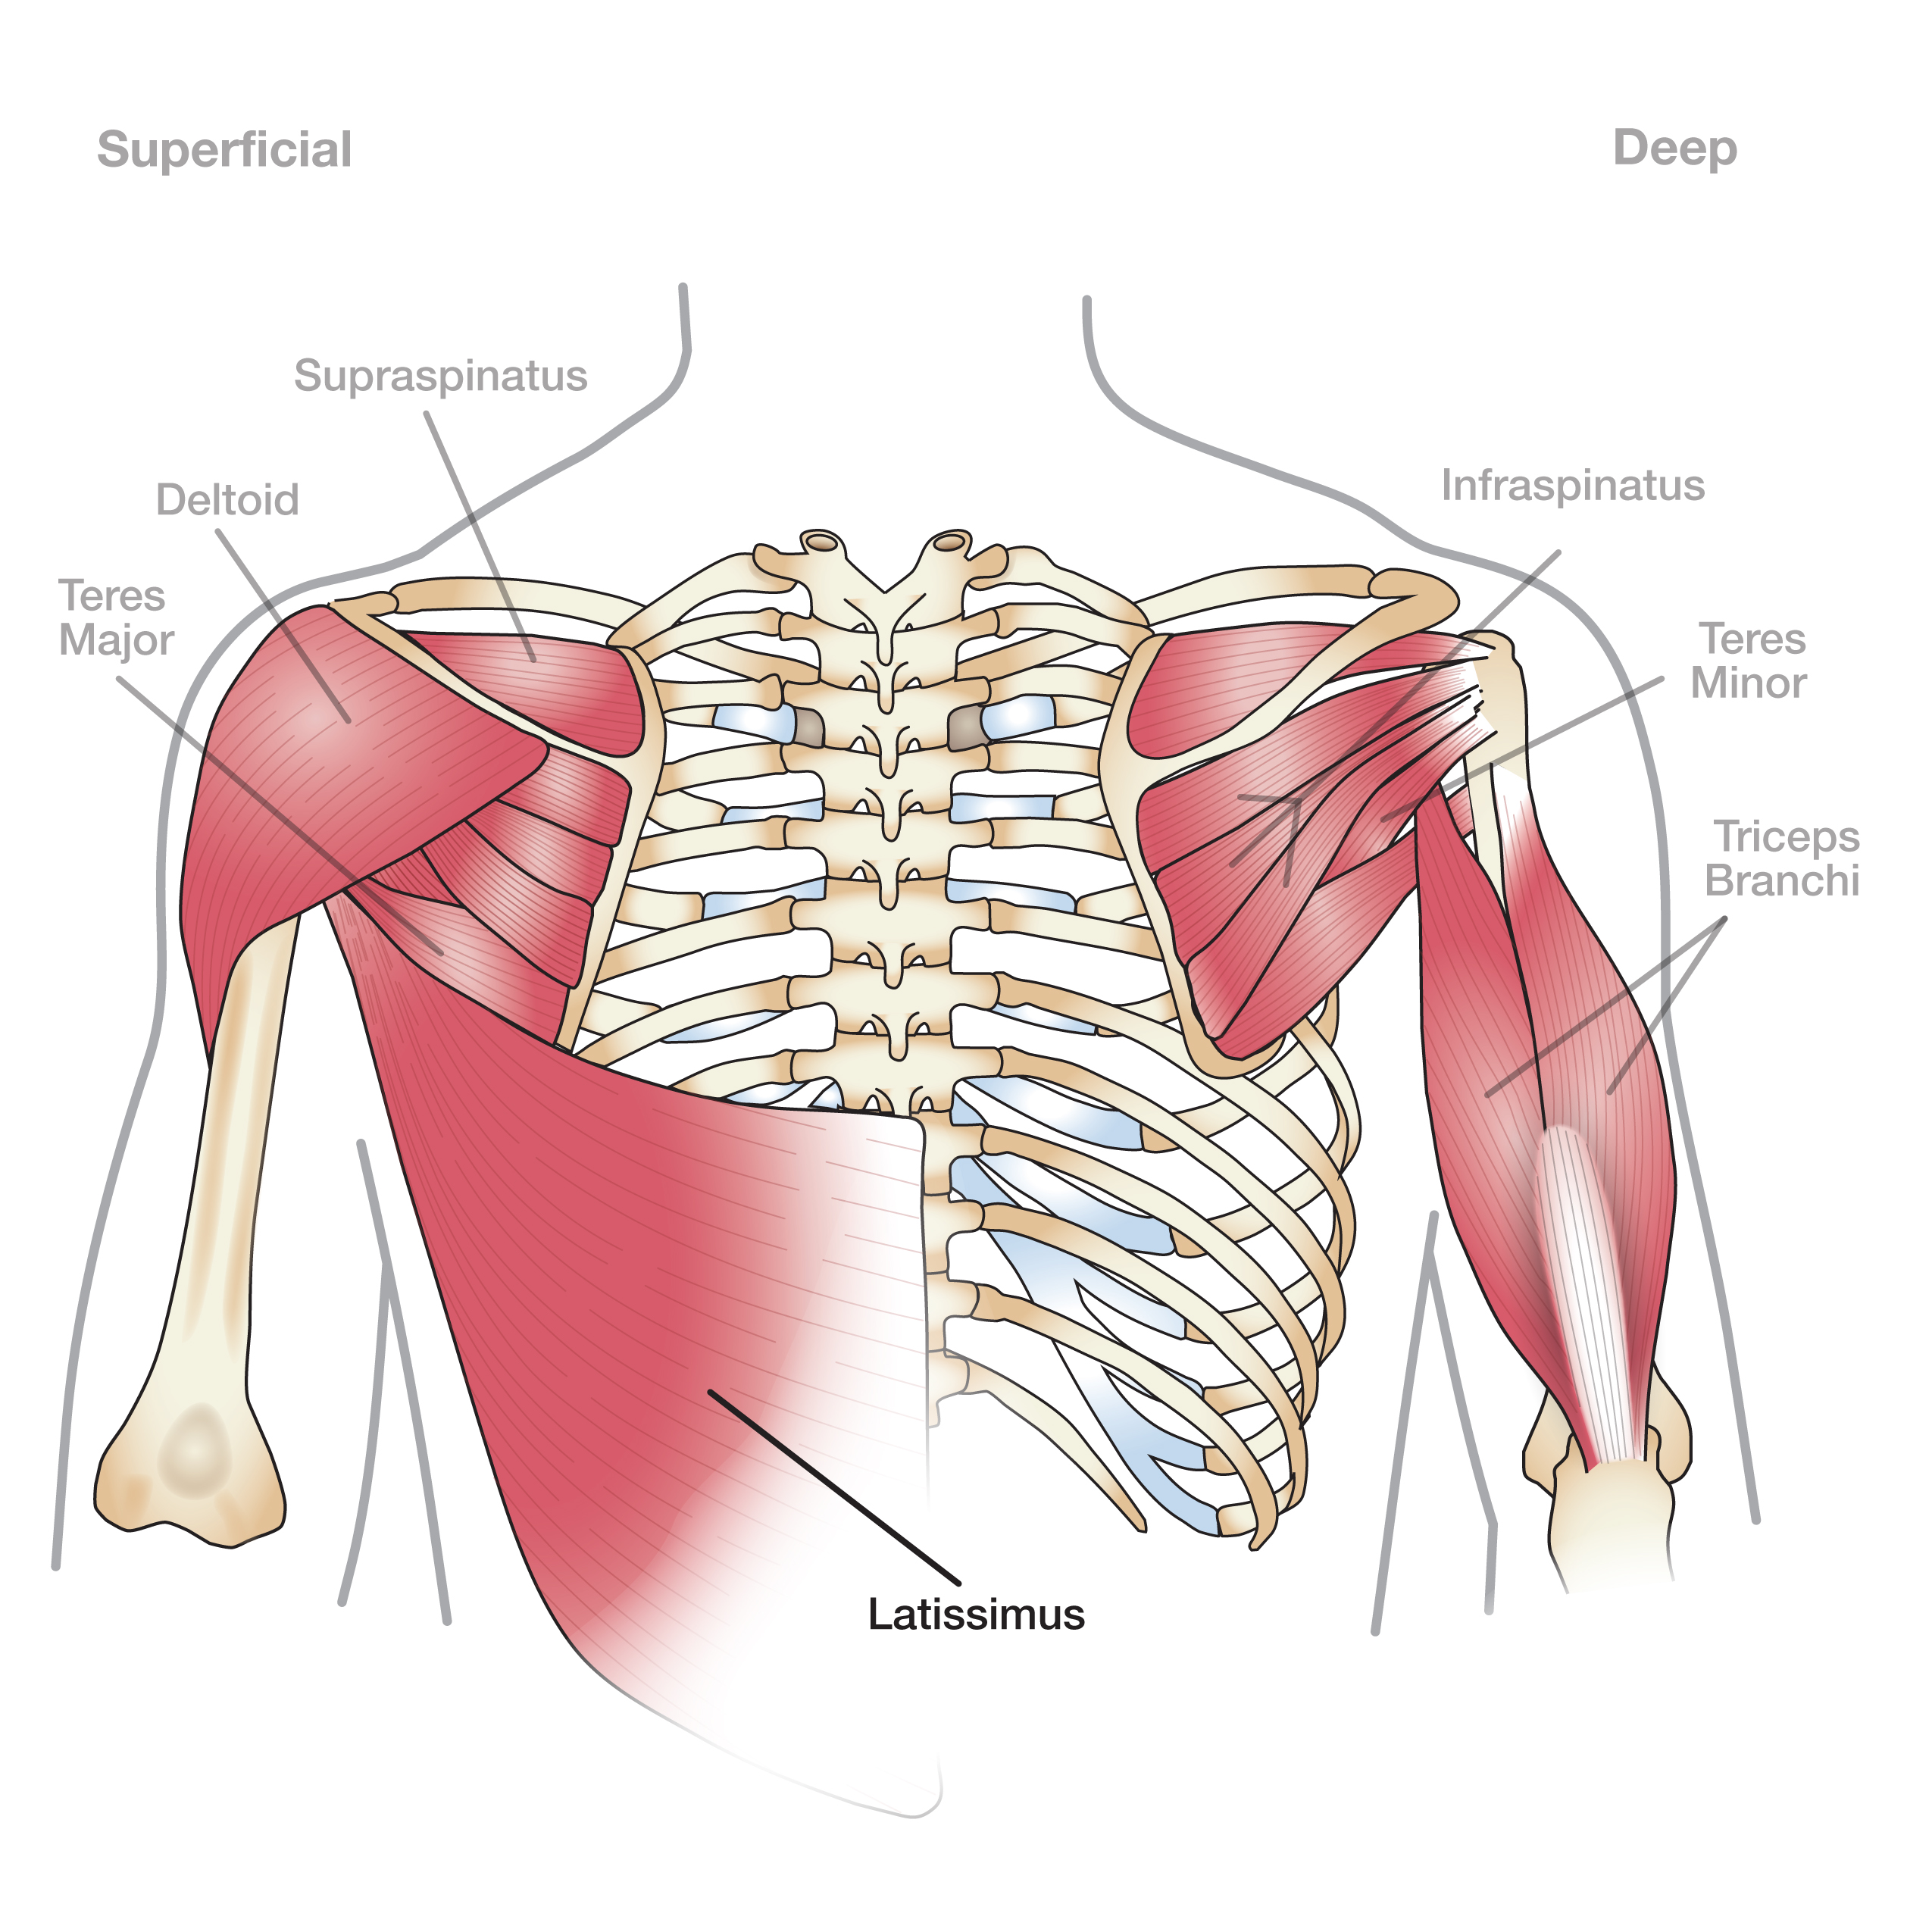
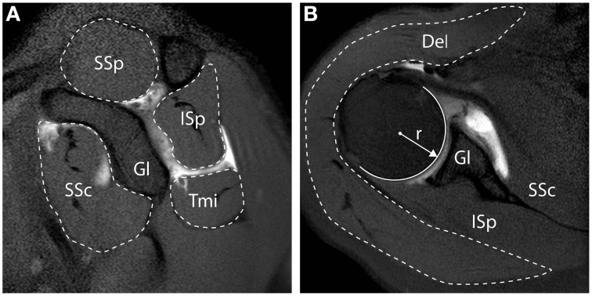
Age-associated shoulder diseases
PMID: 26733863

Slide 20
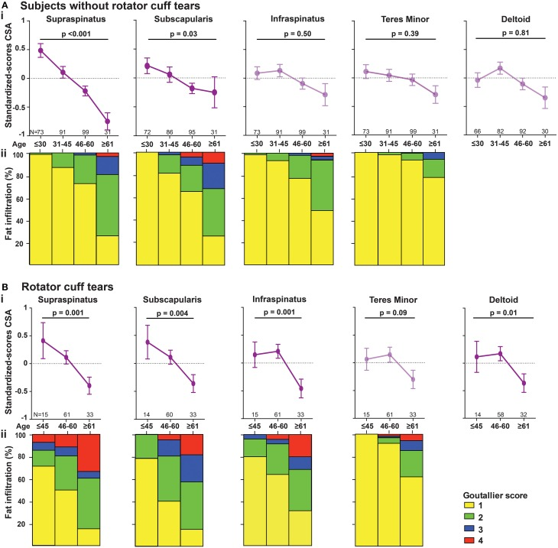
Progression of RC tear is age-associated
In the shoulder joint, muscle involvement is age-associated
PMID: 26733863

Slide 21
What is a multifactorial process?
Spatial (MRI)
- All tissues or
- A tissue specific involvement
Temporal
- Age of onset
- Age-associated pattern
Molecular
- Key regulators vs. multiple regulators
- Key cellular processes vs. multiple processes
Prediction models

Slide 22
The globaltest: determine whether a global expression pattern of all genes or a group of genes is significantly related to a feature, such as disease, clinical feature, biological pathway or physiological condition.
Assessment of aging using molecular data system
Large dataset (omics) - statistics
J. Goeman

Slide 23
Age-associated expression profiles in human organs
The globaltest in cross-sectional RNA microarray
Effect size
Raz and Goeman

Slide 24
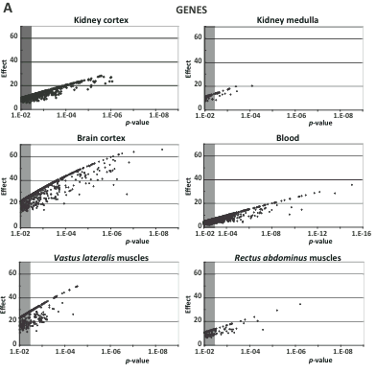
Globaltest analysis in Aging datasets
NS
Small effect size
Small effect size
NS
Raz and Goeman

Slide 25
Globaltest analysis in Aging datasets
NS
Small effect size
Heterogenic cell system
Small effect size
Skeletal muscles
NS
Smooth muscles
Raz and Goeman
Notes:
Smooth muscles are simulated by the autonomous nerve system
Skeletal muscles are simulated sirectly by the neuromotor

Slide 26
Globaltest analysis in Aging datasets
NS
Small effect size
A tissue-specific molecular age-associated changes
Heterogenic cell system
Small effect size
Skeletal muscles
NS
Smooth muscles
Raz and Goeman
Notes:
Smooth muscles are simulated by the autonomous nerve system
Skeletal muscles are simulated sirectly by the neuromotor

Slide 27
What is a multifactorial process?
Spatial (RNA expression profiles)
- all tissues or
- Tissue specific involvement
Temporal
- onset
- age-associated pattern
Molecular
- Key regulators vs. multiple regulators
- Key cellular processes vs. multiple processes
Prediction models

Slide 28
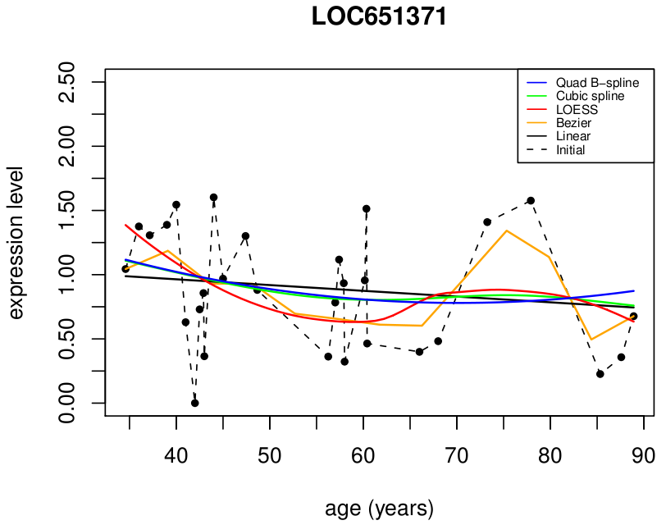
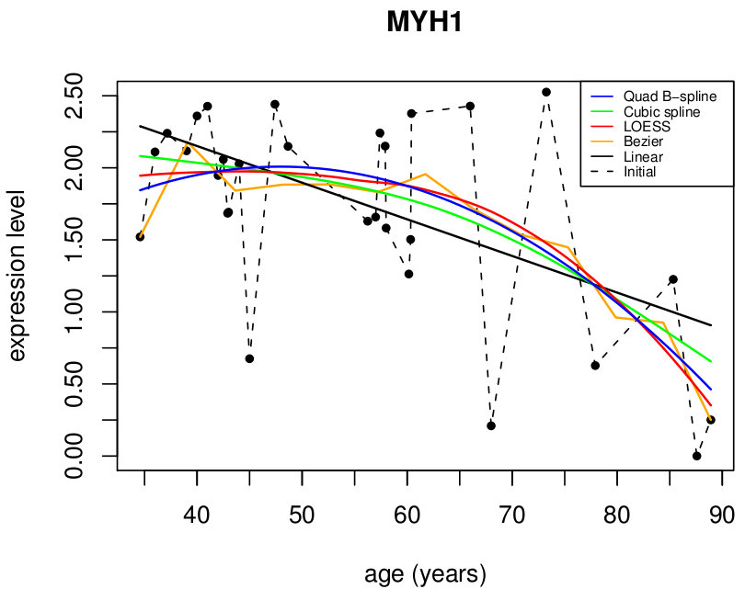
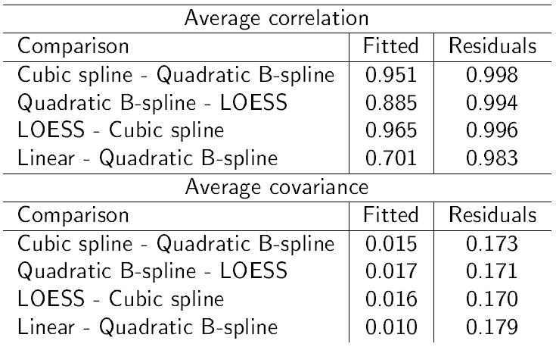
Age-associated temporal changes: which model is the best?
A
Regression models:
which to use in
aging studies?
PMID: 24524210

Slide 29
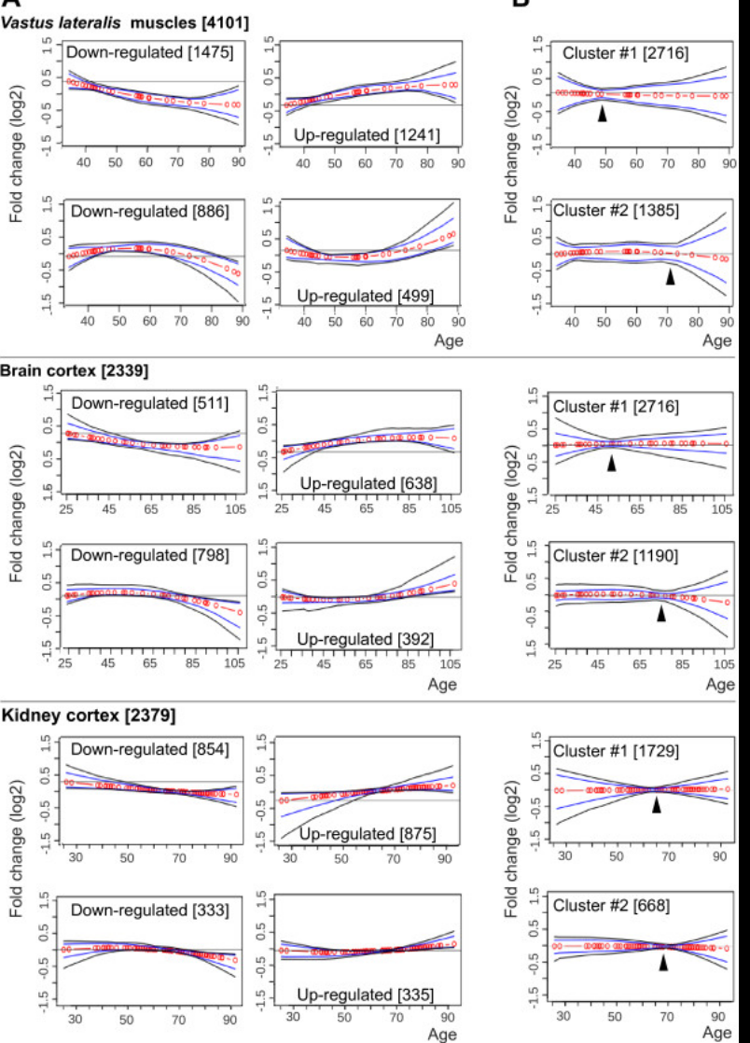
Age-associated temporal changes
A bio-statistical approach
PMID: 24524210

Slide 30
Age-associated temporal changes
A bio-statistical approach
A tissue specific progression
PMID: 24524210

Slide 31
What is a multifactorial process?
Spatial (RNA expression profiles)
- all tissues or
- Tissue specific involvement
Temporal
- Age of onset (??)
- Tissue specific age-associated pattern
Molecular
- Key regulators vs. multiple regulators
- Key cellular processes vs. multiple processes
Prediction models

Slide 32

Key regulators vs. multiple regulators Key cellular processes vs. multiple processes
Molecular examples:
33

Slide 33
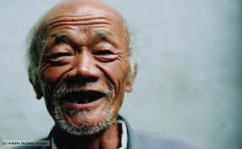

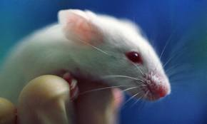
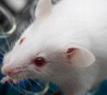
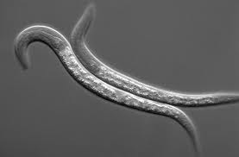
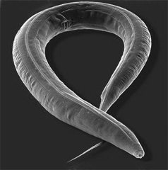
Aging – model organisms
adulthood
Human
Years
Months
mouse
worm
Days
Time scale
The choice of the model system

Slide 34
Which model to choose?
Every group gets a different an aging-related assignment:
Describe the ageing-associated condition (problem): consider tissue specificity, age of onset, progression.
Discuss potential models for the condition and the tools to develop potential option(s) to study it in order to develop therapy.
Aim: to find the fastest and least expensive path to develop a therapy
Aid: Attached literature

Slide 35
Conditions:
Sarcopenia :reduced muscle function: muscle weakness and atrophy
Dementia: reduced cognitive capacity with age
Autoimmune disorders: reduced ability to distinguish self from nonself (identification of foreign antigens
Arthrosis: Degeneration of connective tissues

Slide 36
literature:
Sarcopenia :reduced muscle function: muscle weakness and atrophy
10.1016/j.ijcard.2017.03.152
https://www.sciencedirect.com/science/article/pii/S0142961215002483
Dementia: reduced cognitive capacity with age
https://doi.org/10.1016/j.neubiorev.2020.02.012 10.1016/j.brainres.2019.146427
Autoimmune (blistering) disorders: reduced ability to distinguish self from nonself (identification of foreign antigens
https://onlinelibrary.wiley.com/doi/full/10.1111/exd.13415
Arthrosis: Degeneration of connective tissues
https://www.sciencedirect.com/science/article/abs/pii/S0014299915002642

